Slide 1
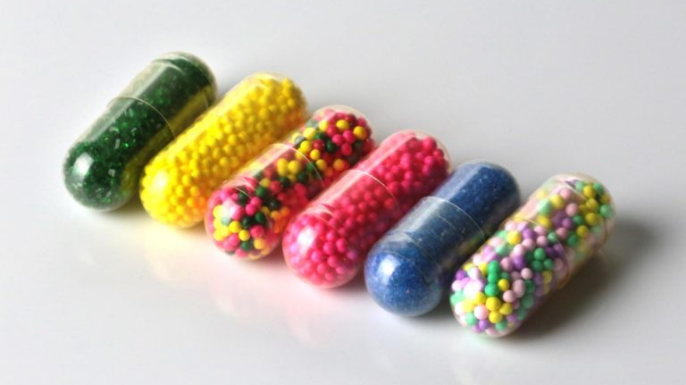
E-Compliance: Detecting Non-Compliant Therapeutic Goods on E-commerce Websites
Swikriti Chapai
Parbat Khadka
Matthew Borowski
Dylan Henderson
This Photo by Unknown Author is licensed under CC BY-SA-NC
Notes:
Title and names slide

Slide 2

The Project
Collect product information from e-commerce sites (Amazon)
Determine which products are compliant or
non-compliant by TGA standards

Slide 3

What is a Therapeutic Good
Medicines
Biologicals
Medical Devices

Slide 4
Types of Non-Compliant Therapeutic goods
Products with poisonous ingredients
Products making false therapeutic claims
Non ARTG approved
Notes:
Non ARTG approved products are ones that have not been approved for use in australia.
Making unsubstantiated claims like curing incurable diseases or being all-natural when it isnt all-natural

Slide 5
Scope
Original:
Our choice of 2 E-Commerce websites to extract product information
Revised:
Scrape product information from just Amazon.com.au

Slide 6
Importance of Detection
Maintain customer's trust
Public's Helath
Prevent dishonest behaviour
Maintaining regulatory compliance

Slide 7
Purpose of the project
Create
Create an automated system for detecting non-compliant therapeutic goods
Protect
Protect the health and safety of the public from non-compliant goods
Develop
Develop awareness and educate consumers about unregulated products
Notes:
Our project and presentation is to intend awareness about the risk connected with collecting such products online .
Main goal is to educate consumers about the risk of purchasing medications from unregulated sources which may include fake, outdated, or unsafe goods that are ineffective or harmful.
The project can also serve as a warning to non-compliant therapeutic products makers and sellers that their actions will not be allowed, and they will face legal consequences for violating regulatory standards.
Overall, the major purpose of this presentation is to protect public health and safety by preventing the sale and use of non-compliant therapeutic goods and encouraging consumers to make informed healthcare product purchases.

Slide 8
Literature Review
Online therapeutic products often have unauthorized health claims and inaccurate information.
Studies found high percentages of products with these issues, including claims for pain, anxiety, and serious illnesses.
To protect consumers, increased regulation and monitoring of online therapeutic products is necessary.
Audits of companies and education campaigns for consumers can help prevent the sale of non-compliant products.
Notes:
What are something we found in the literary review?
How did that affect our project?

Slide 9

System Overview
Notes:
Web Scraping -> Compliance Checks -> Output

Slide 10
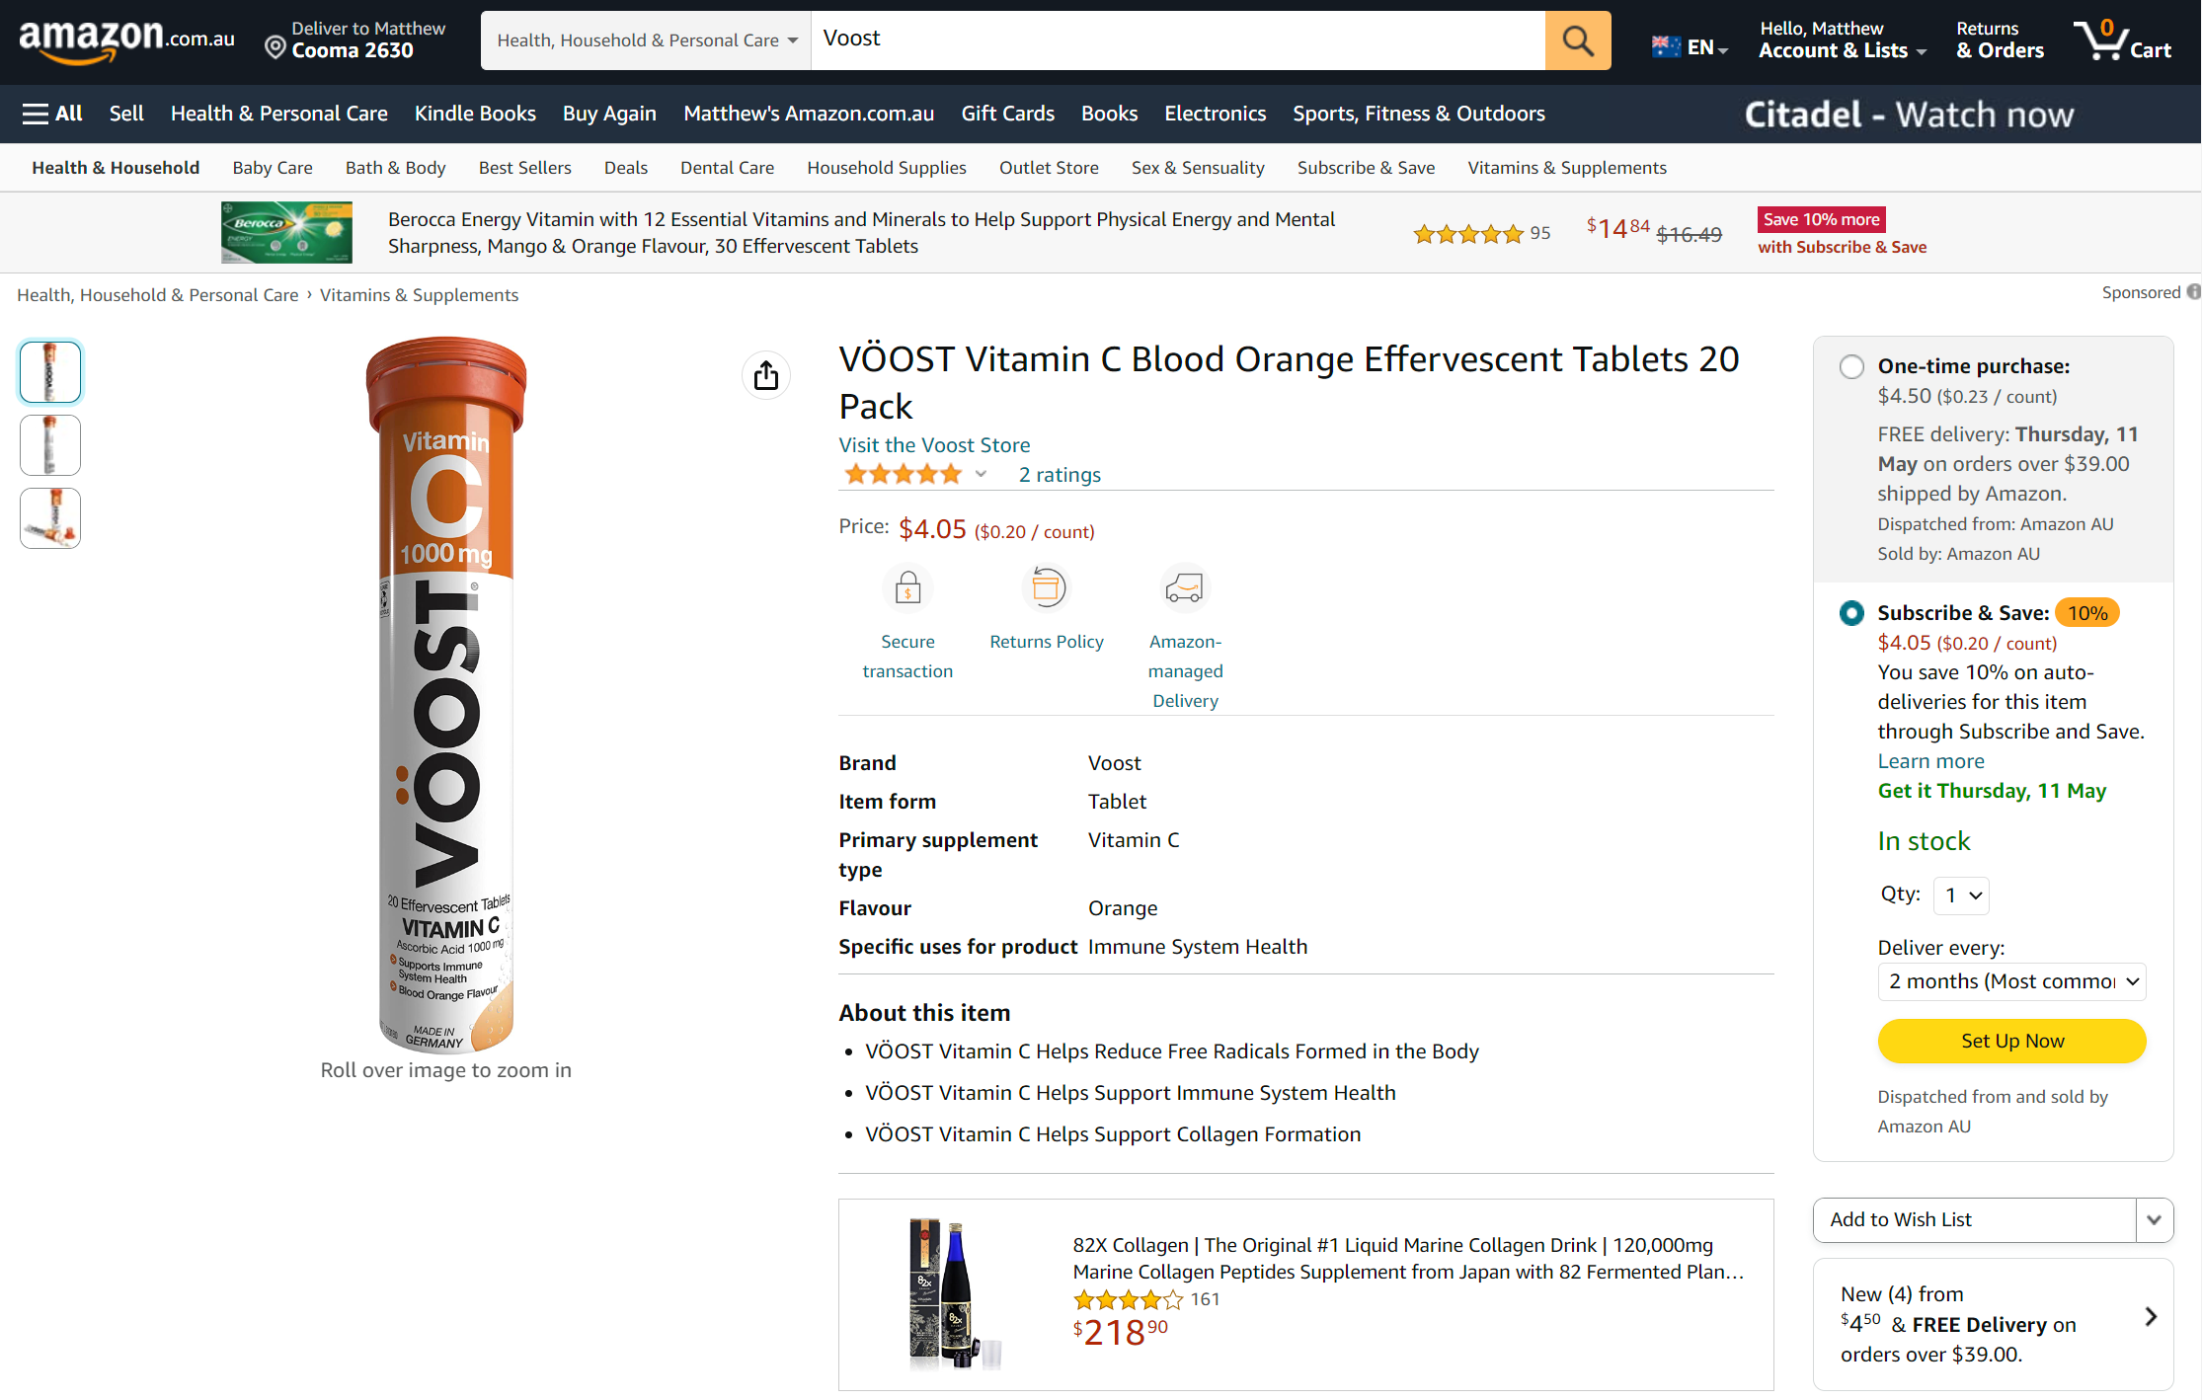
Notes:
Product Name
Seller name
Searching keywords
Image attached on the list
Collected date

Slide 11
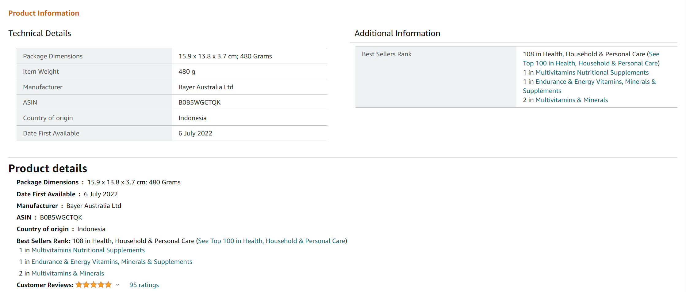
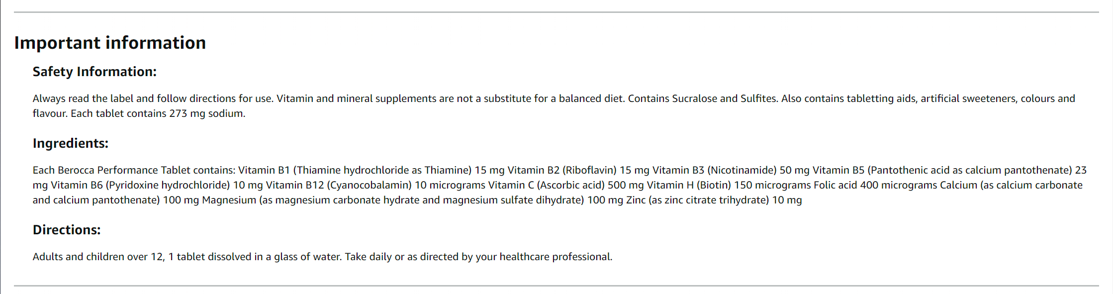
Notes:
Manufacturer
ASIN
Contained Ingredients

Slide 12
Compliance Checking
No False Therapeutic Claims
Approved ARTG Number
Contains No Poisonous Ingredients
Notes:
Keyword search for claim check
ARTG number is checked against a list of TGA approved products
Ingredients are checked against a list of poisonous ingredients that cannot be in products.

Slide 13
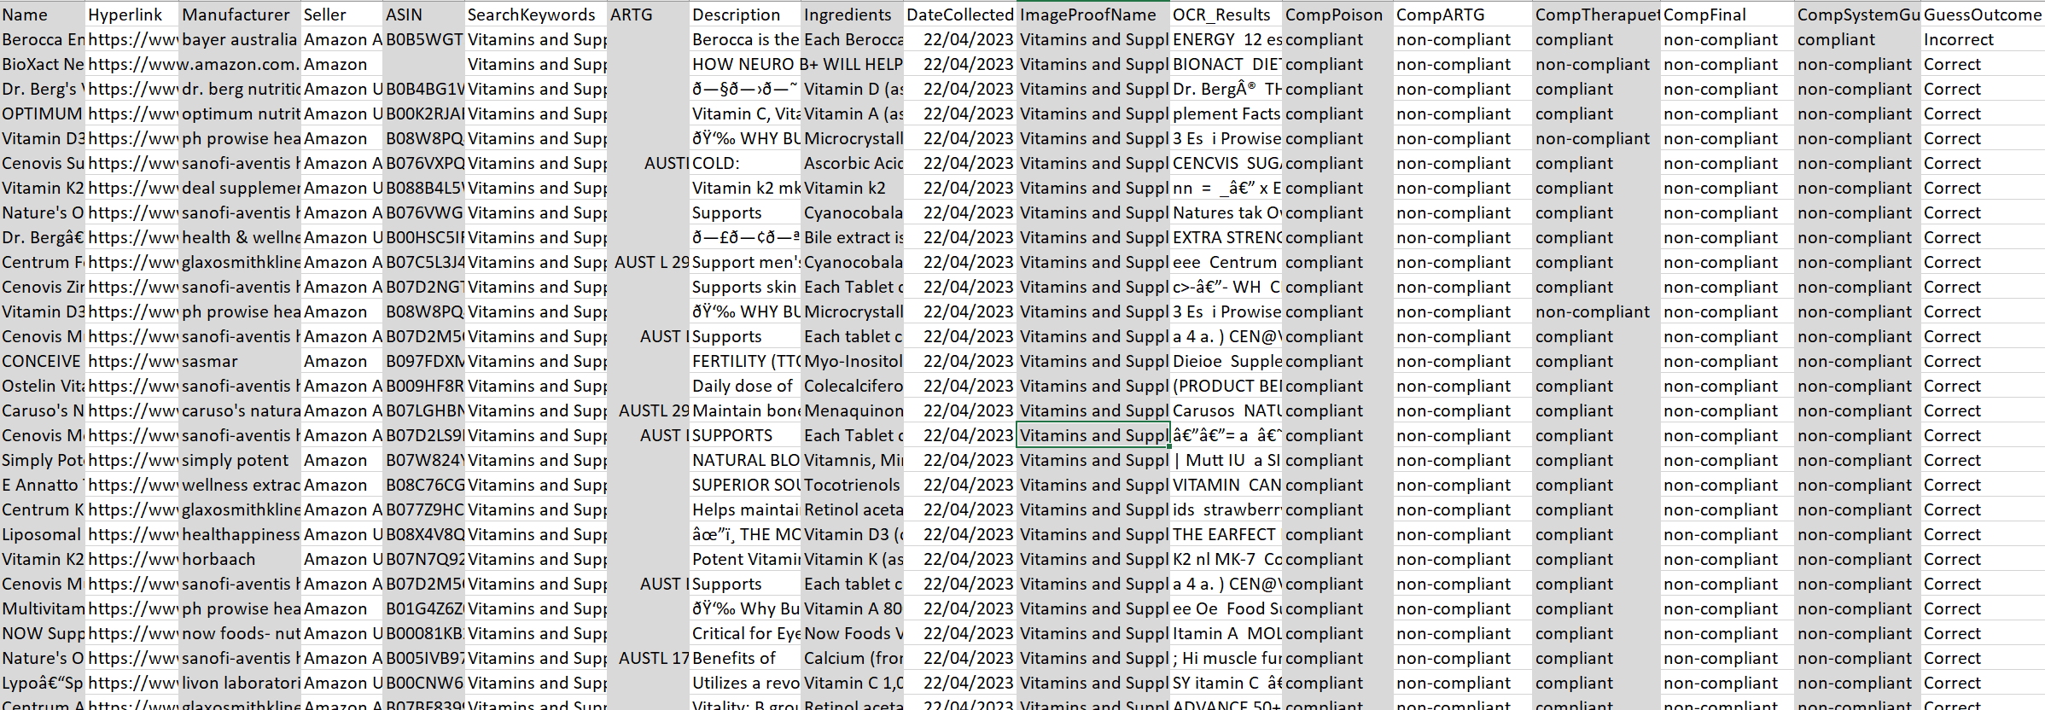
Output
Notes:
Finally, the output is created by collecting all the non-compliant products and creating a csv file

Slide 14
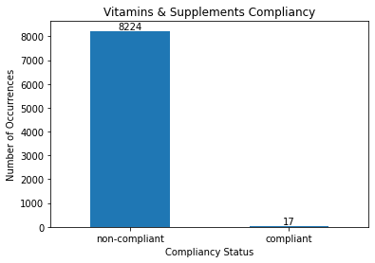
Compliancy
Problems :
ARTG numbers
Misreads during OCR
International Images
Bulk Packaging
Expected:
Less overlap with just one specific compliance check

Slide 15



Slide 16
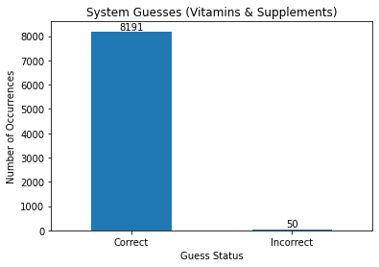
System Guess
Problems :
Simple method
Misread manufacturer name and fell into the correct answer
Expected:
Less correct results due to simple method of guessing

Slide 17
Limitations of our solution
Collecting the data takes time
Incorrect or incomplete product info
Ambiguity of product claims
Updating product information
Non-English product info
We can't collect what we can't find
OCR isn't optimised
Simple guessing method

Slide 18
Future Improvements
User Interface
Pre-processing OCR
Web scrape Speed
More e-commerce websites
Results Dashboard

Slide 19
Prevention and Compliance Strategies
E-commerce platform responsibilities
Seller responsibilities
Collaboration between regulatory bodies and e-commerce platforms
Educational campaigns for consumers
Notes:
Title change, can be some used for how we think some of these ideas can ensure safety for australian public etc.

Slide 20
Lesson learnt
Clarifying what inputs and the output should look like when designating a programming tasks.
Thinking through how much of a time commitment is expected from each team member's role before dividing them up.

Slide 21
Thank You. Questions?
Notes:
Title and names slide

